Slide 1
Investigating the Gut Microbiota of Sick and Healthy dogs
Maya Craig
BIOMI 6300

Slide 2

Connecting health and microbiota
Understanding changes in the microbiome in association with disease onset can open the door for new therapeutics
Probiotics and targeted/personalized therapy
Bai et al. investigated the difference in gut microbiota and metabolome profiles of dogs with and without diarrhea
Cornell University, 2024

Slide 3
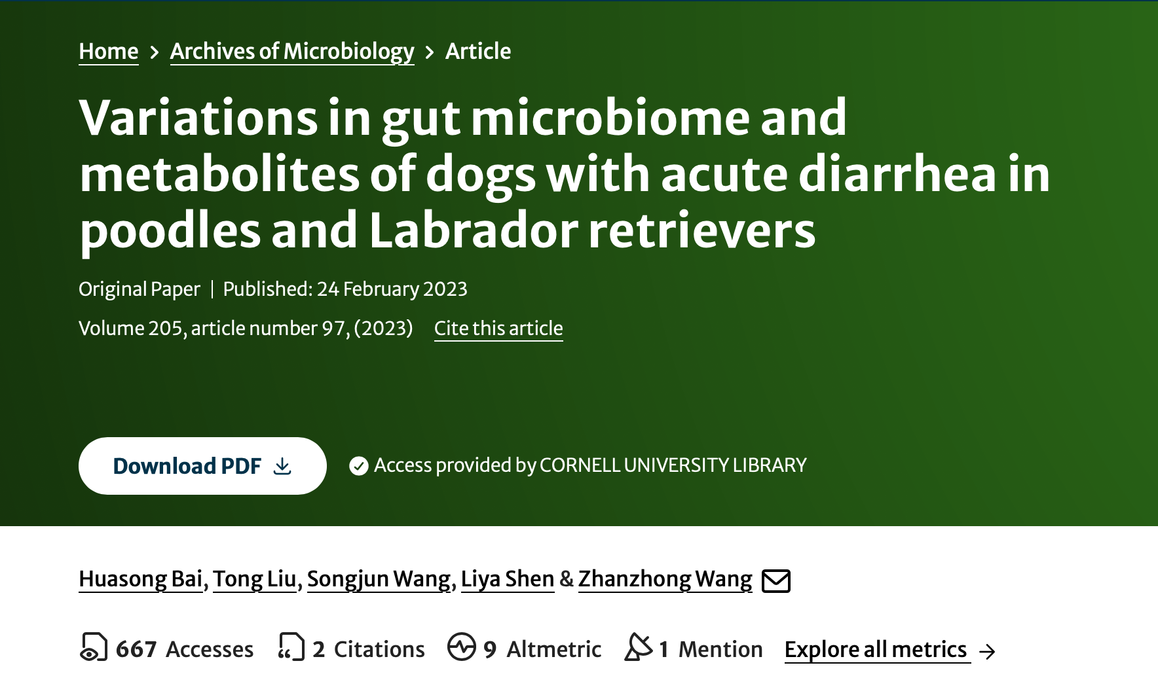
Investigative question(s)
Are there significant differences in the gut microbiota of different breeds with and without acute diarrhea?
Am I able to replicate the same results as Bai et al.?
Hypothesis: Differences in gut microbiota between healthy and sick dogs exist and can be identified using 16S amplicon analysis.

Slide 4


Study Design
😊
x12
😊
x12
In total…
48 fecal samples
2 dog breeds
Healthy cohort of 24
Diarrhea cohort of 24
🤢
x12
🤢
x12
Notes:
Prospective observational study

Slide 5
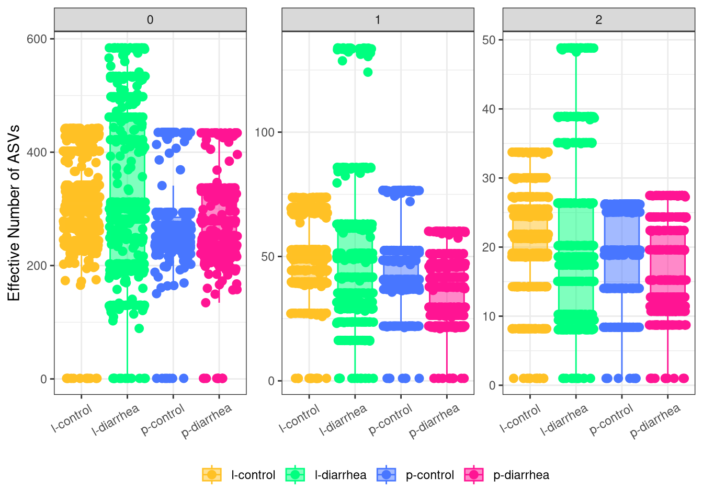
Alpha diversity
Labradors with diarrhea (green) have the highest range of richness
Less of an obvious difference between the number of common and dominant taxa between to two breeds and health conditions
Notes:
Although I did not so statistical testing for significant differences, I can observe that LD has the highest range of richness, and the common and dominant amount of taxa are comparable

Slide 6
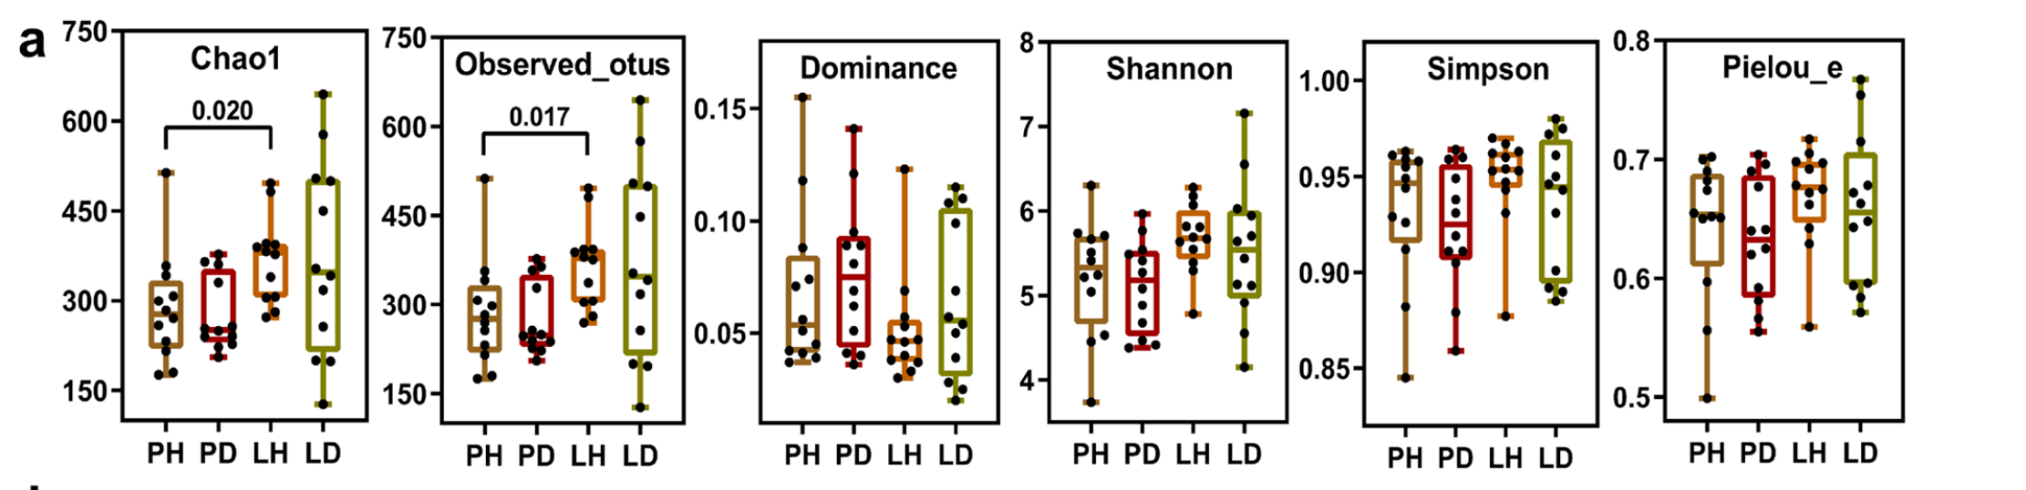
Bai et al. alpha diversity
Significant difference in observed OTUs between PH PD and LH, but not for any other diversity metric that was calculated
Notes:
Difficult to directly compare because I used Hill diversity and Bai et al did not. But it looks like LD has the highest richness, although there is not a significant difference between LD and the other samples. But there is a significant difference in the richness of PH and LH samples
Not significant difference between dominant, Shannon, or Simpson
Bai et al did not use rarefaction and removed ASVs that have a count less than 5

Slide 7
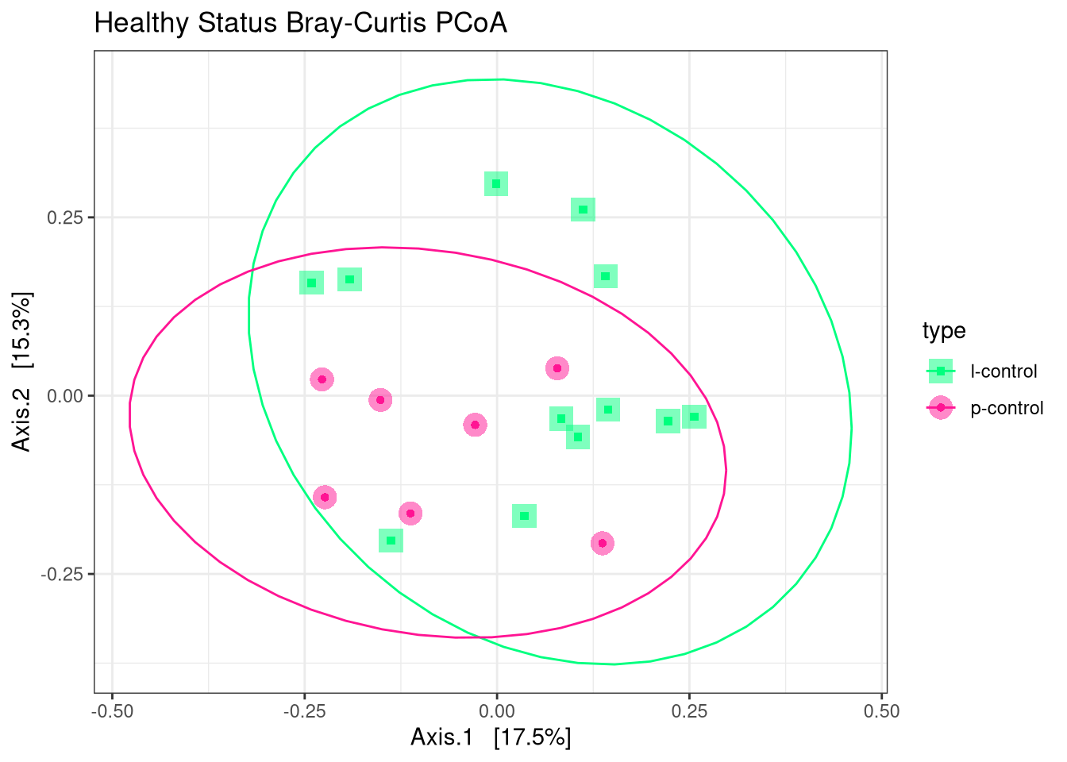
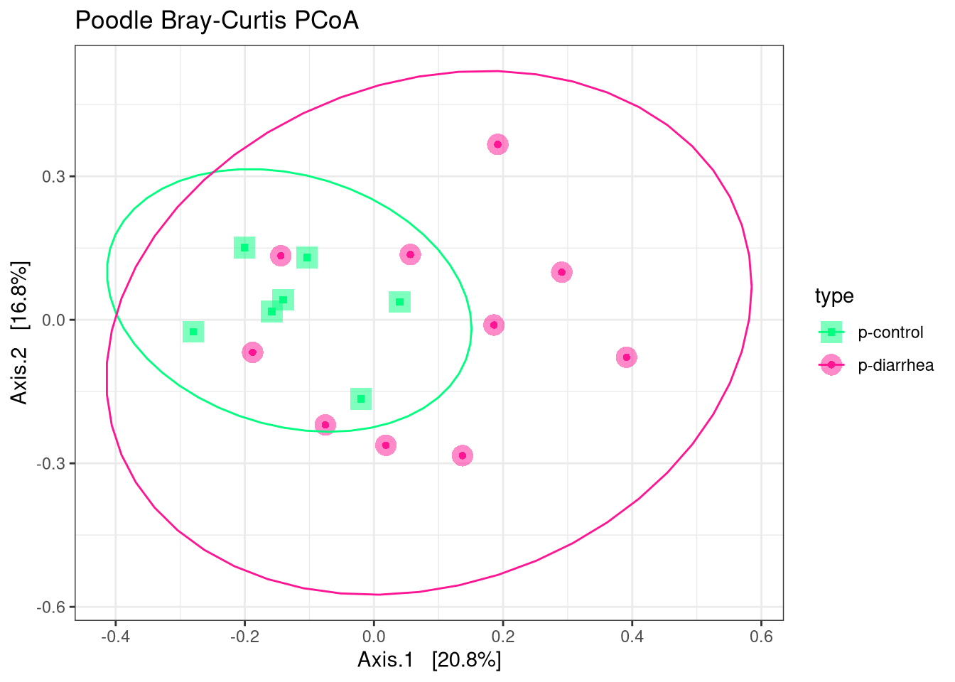
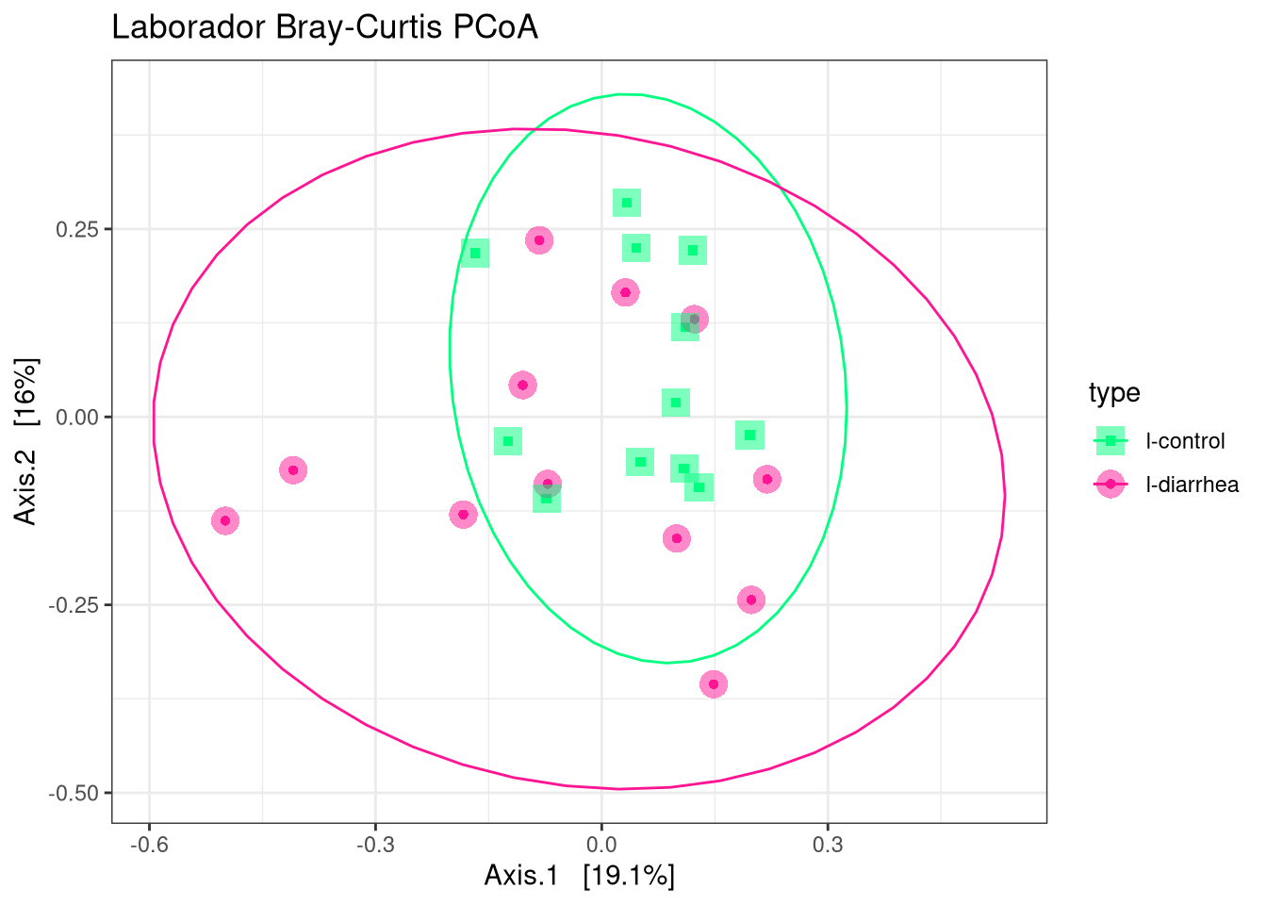
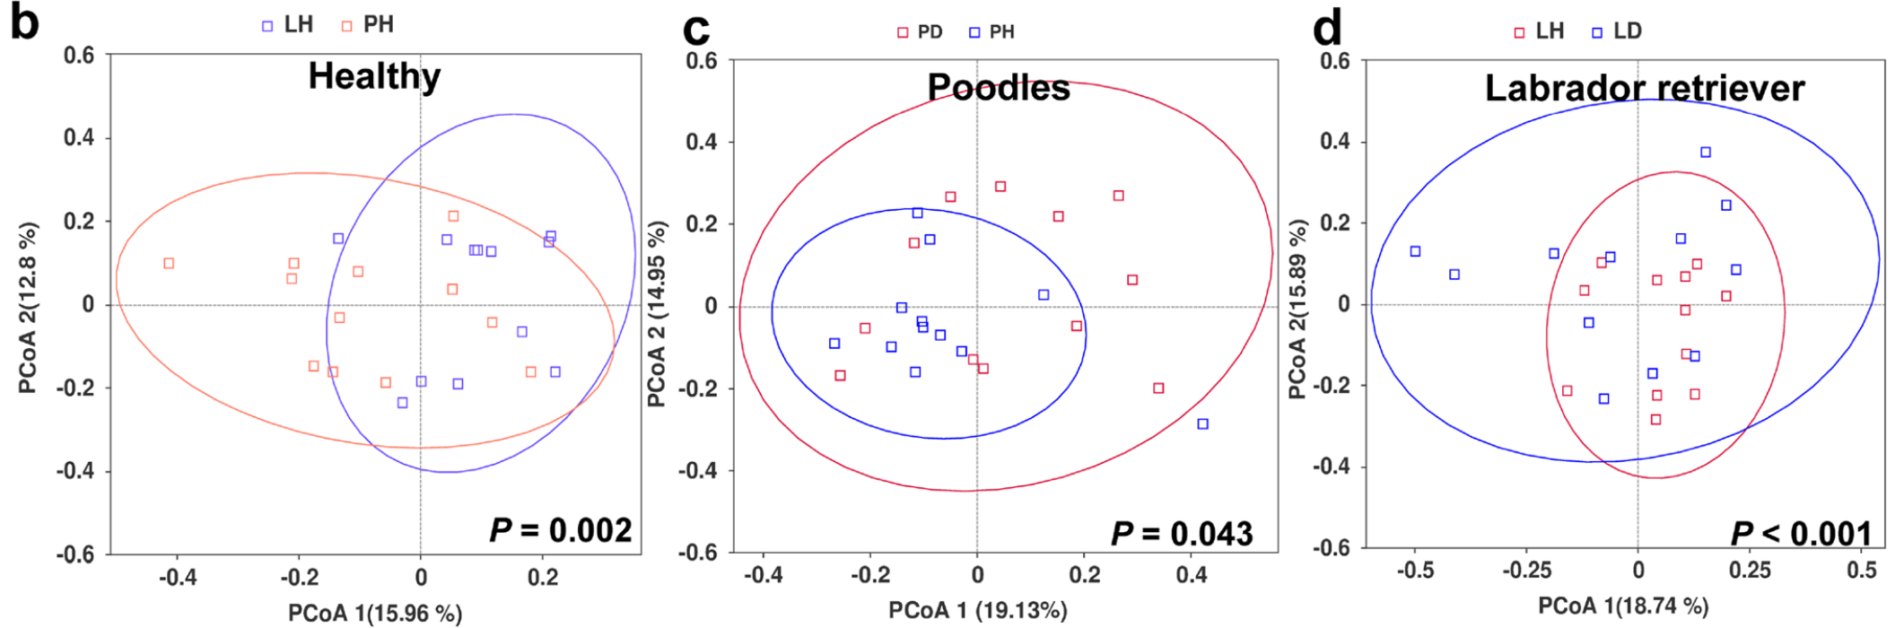
P=0.007
R2 = 0.10
F = 1.98
P=0.046
R2 = 0.98
F = 1.63
P=0.10
R2 = 0.06
F = 1.41
Notes:
p-value from Wilcoxon rank sum test in QIMME
Made pcoa plots in r
Main conclusion from Bai et al: Acute diarrhea has led to alterations in gut community structure and diversity in dogs

Slide 8
Summary of beta diversity statistics
Specifically, both my analysis and the Bai et. al. 2023 found that microbial diversity differed significantly between Poodles and Labradors in the healthy cohort.
However, Bai et al found significant differences in microbial communities in dogs with acute diarrhea and healthy dogs for both the Labrador and Poodle cohorts. In my analysis, I did not find this same significant difference.
Bai et al only used Bray-Curtis PCoA for beta diversity evaluation and Wilcoxon rank sum test for statistical testing. This could explain why we have different results.

Slide 9
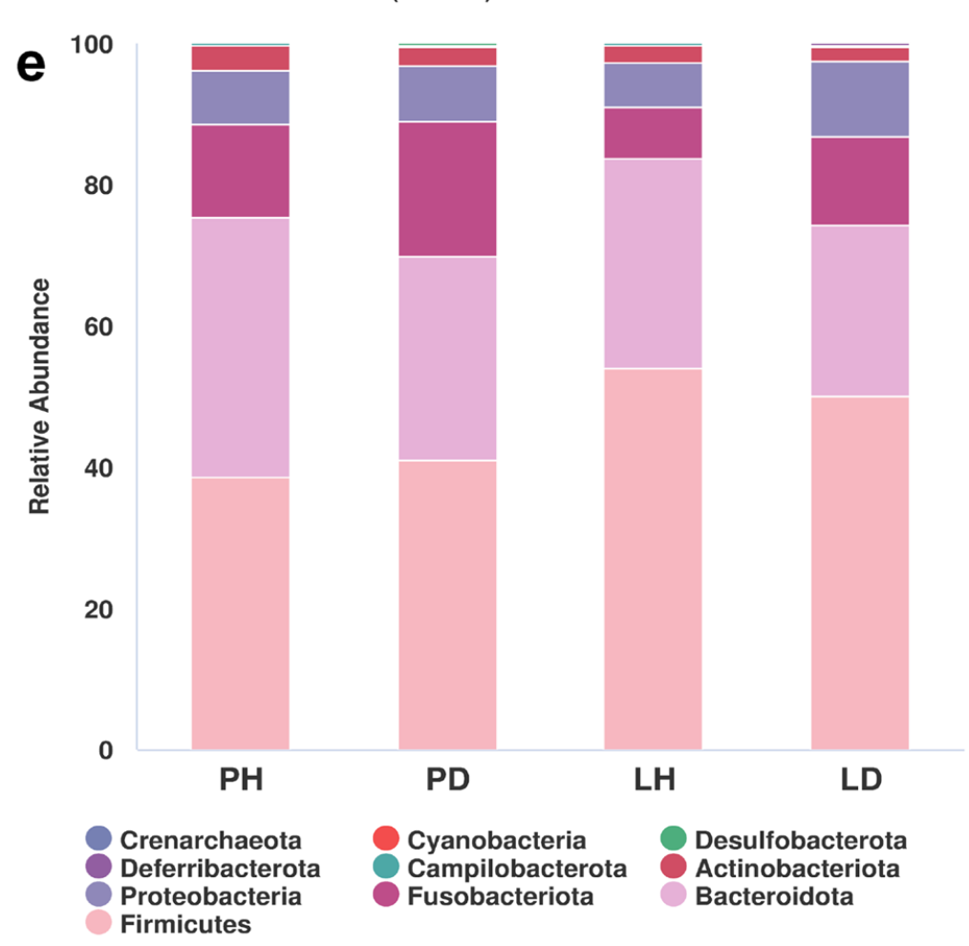
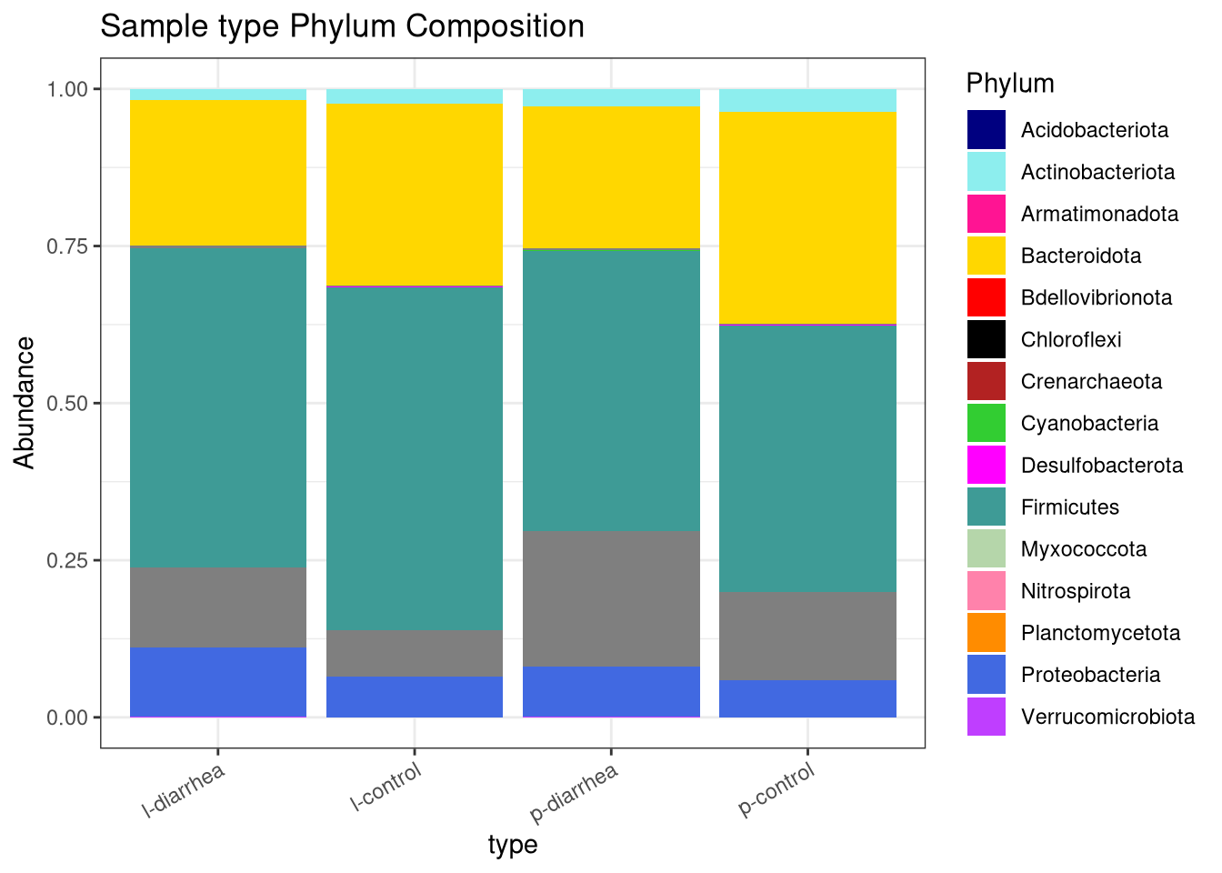
Comparing taxa
Moon et al., 2018
Notes:
The stacked taxonomy plots were similar between my analysis and Bai et al. analysis. Both agree that Bacteroidota and Proteobacteria are common taxa in the samples. I choose to further investigate these two phylum because Bacteroidota is associated with normal/healthy gut flora, and Proteobacteria is more associated with infection. Based on the bar plots, it looks like there could be a difference in the mean number of these phyla in healthy versus diarrhea samples

Slide 10
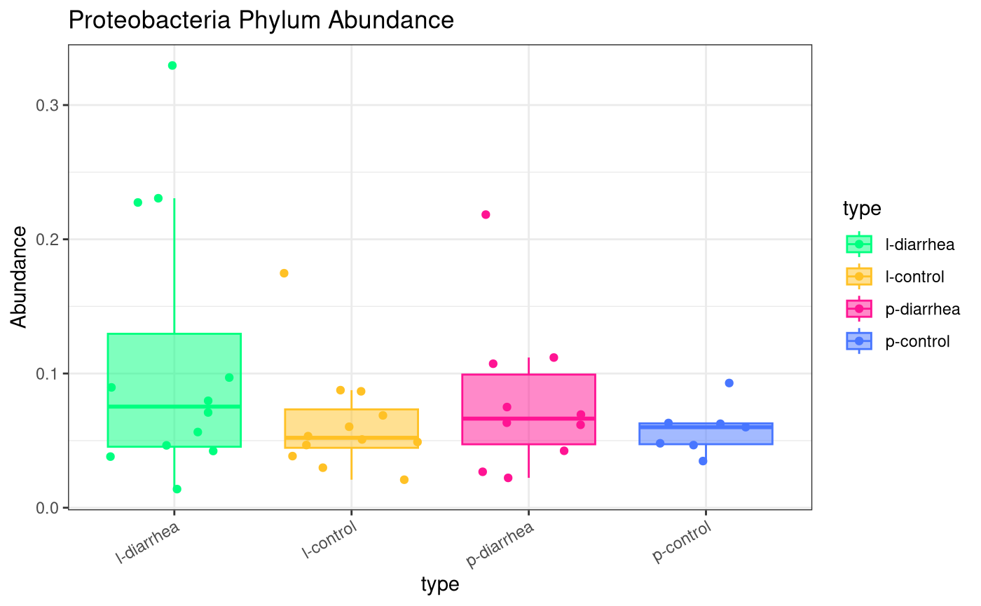
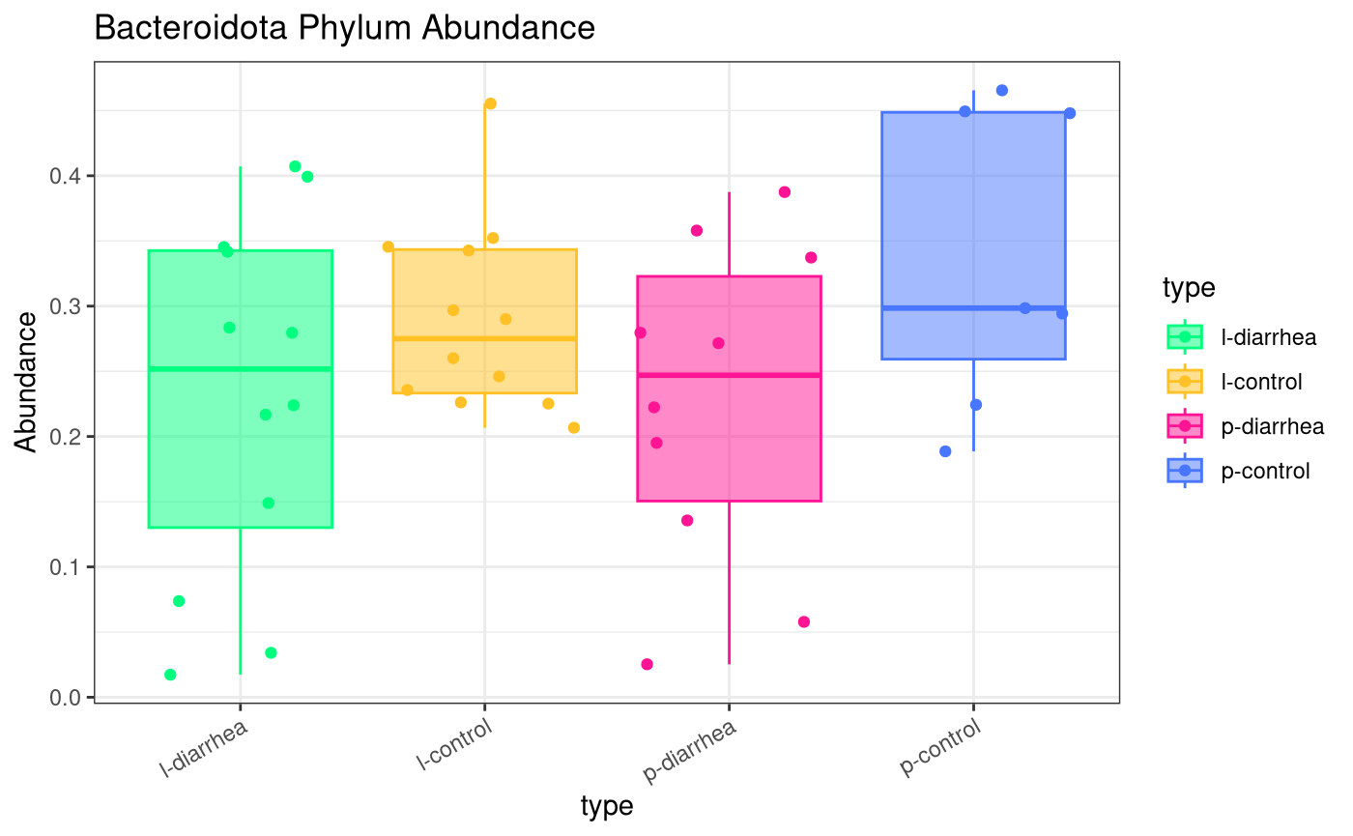
Examining Proteobacteria and Bacteroidota
Looks like there could be a difference of Proteobacteria and Bacteroidota in healthy vs control samples, but statistical analysis is needed to confirm this difference!
Notes:
Bai et al found that Proteobacteria was significantly lower in LD compared to LH (using LEFSe aka linear discriminant analysis)
Proteobacteria are found in healthy guts, but higher abundances of it are asscoaited with gastrointestinal illness, opportunistic bacteria
Bai et al found that certain genra belonging to Bacteroidota was higher in the PH than LH

Slide 11


Summary/Conclusions
Alpha diversity metrics agree that LD have the highest range of richness, however this differences is not significant
Bray-Curtis PCoA plots look somewhat similar, however my analysis and Bai et al disagree on the significance of sample type
Both studies agree on common taxa
Proteobacteria and Bacteriodoita can be further investigating as important Phyla in dog gut health
Is there a difference in the gut microbiota of dogs with and without diarrhea?
Yes!
Was I able to replicate the results of the Bai et al study?
Somewhat…

Slide 12
References
Bai, H., Liu, T., Wang, S., Shen, L., & Wang, Z. (2023). Variations in gut microbiome and metabolites of dogs with acute diarrhea in Poodles and Labrador retrievers. Archives of Microbiology, 205(3). https://doi.org/10.1007/s00203-023-03439-6
Moon CD, Young W, Maclean PH, Cookson AL, Bermingham EN. Metagenomic insights into the roles of Proteobacteria in the gastrointestinal microbiomes of healthy dogs and cats. Microbiologyopen. 2018 Oct;7(5):e00677. doi: 10.1002/mbo3.677. Epub 2018 Jun 17. PMID: 29911322; PMCID: PMC6182564.
The power of Probiotics. Cornell University College of Veterinary Medicine. (2024, January 19). https://www.vet.cornell.edu/departments-centers-and-institutes/riney-canine-health-center/health-info/power-probiotics#:~:text=Probiotics%20are%20measured%20in%20colony,easily%20disguised%20in%20a%20treat.

